Slide 1
COLLINS WRITING PROGRAM
IMPROVING WRITING ACROSS THE CURRICULUM

Slide 2
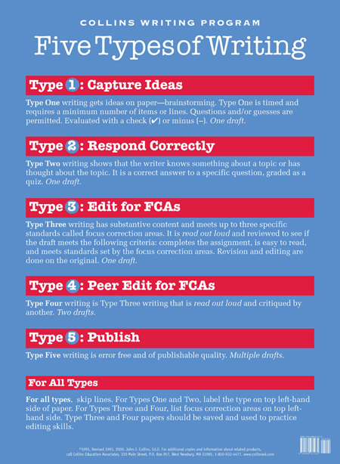
FIVE TYPES OF WRITING

Slide 3
TYPE 1 WRITING
Is writing to get ideas on paper, brainstorming
Is timed and requires a minimum number of lines
Is used to assess students prior knowledge, generate ideas, and explore what the students know about a topic
Requires only one draft

Slide 4
TYPE 1 WRITING
Questions and guesses are permitted
Evaluated with a check or a minus
Students earn a check if they meet the amount of lines required in the time provided
A great way to assess what the students know

Slide 5
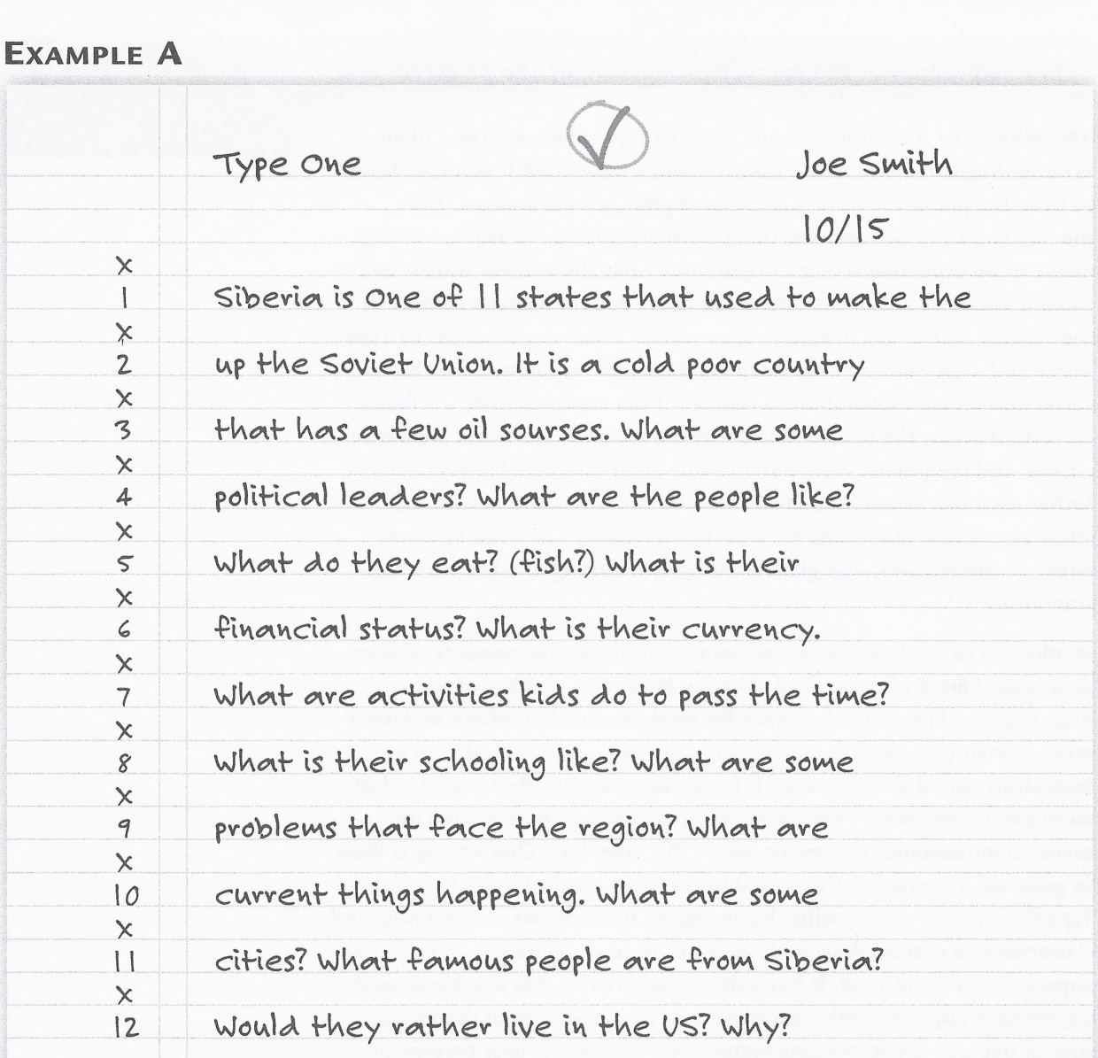
EXAMPLE OF TYPE 1 WRITING

Slide 6
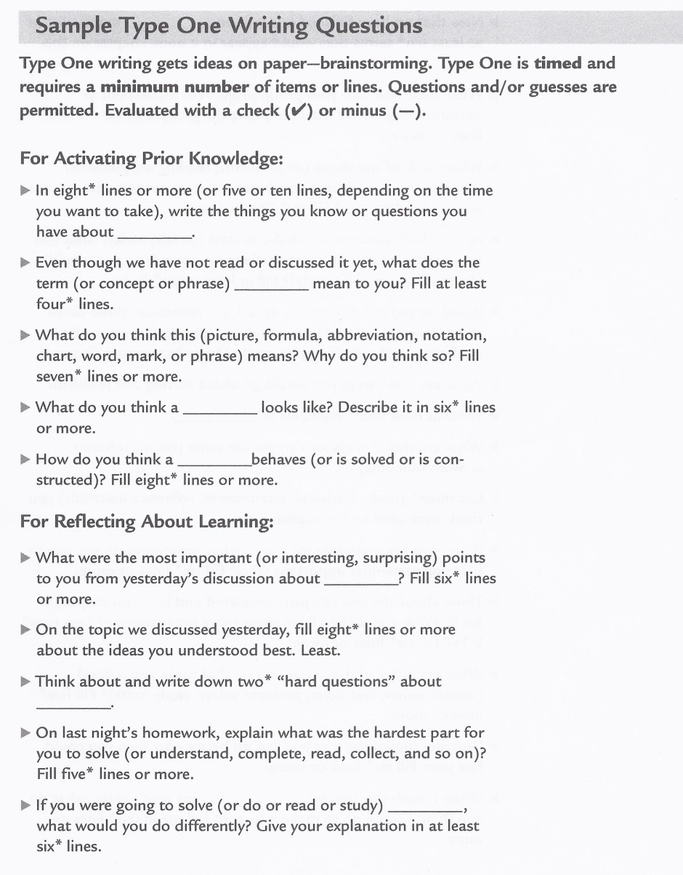
SAMPLE TYPE 1 WRITING PROMPTS

Slide 7
TYPE 2 WRITING
Requires a correct answer and is used best as a quiz
Ask for definitions, facts, explanations, opinions supported with details or new applications
Best used instead of individual questions to students in class to encourage active participation by all students

Slide 8
TYPE 2 WRITING
Must have a clear and definite answer
Evaluated by giving an amount of points for a correct answer
Requires only one draft

Slide 9
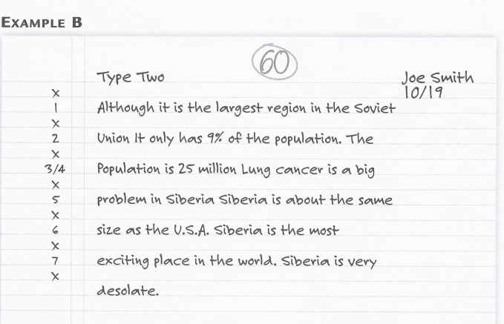
EXAMPLE OF TYPE 2 WRITING

Slide 10
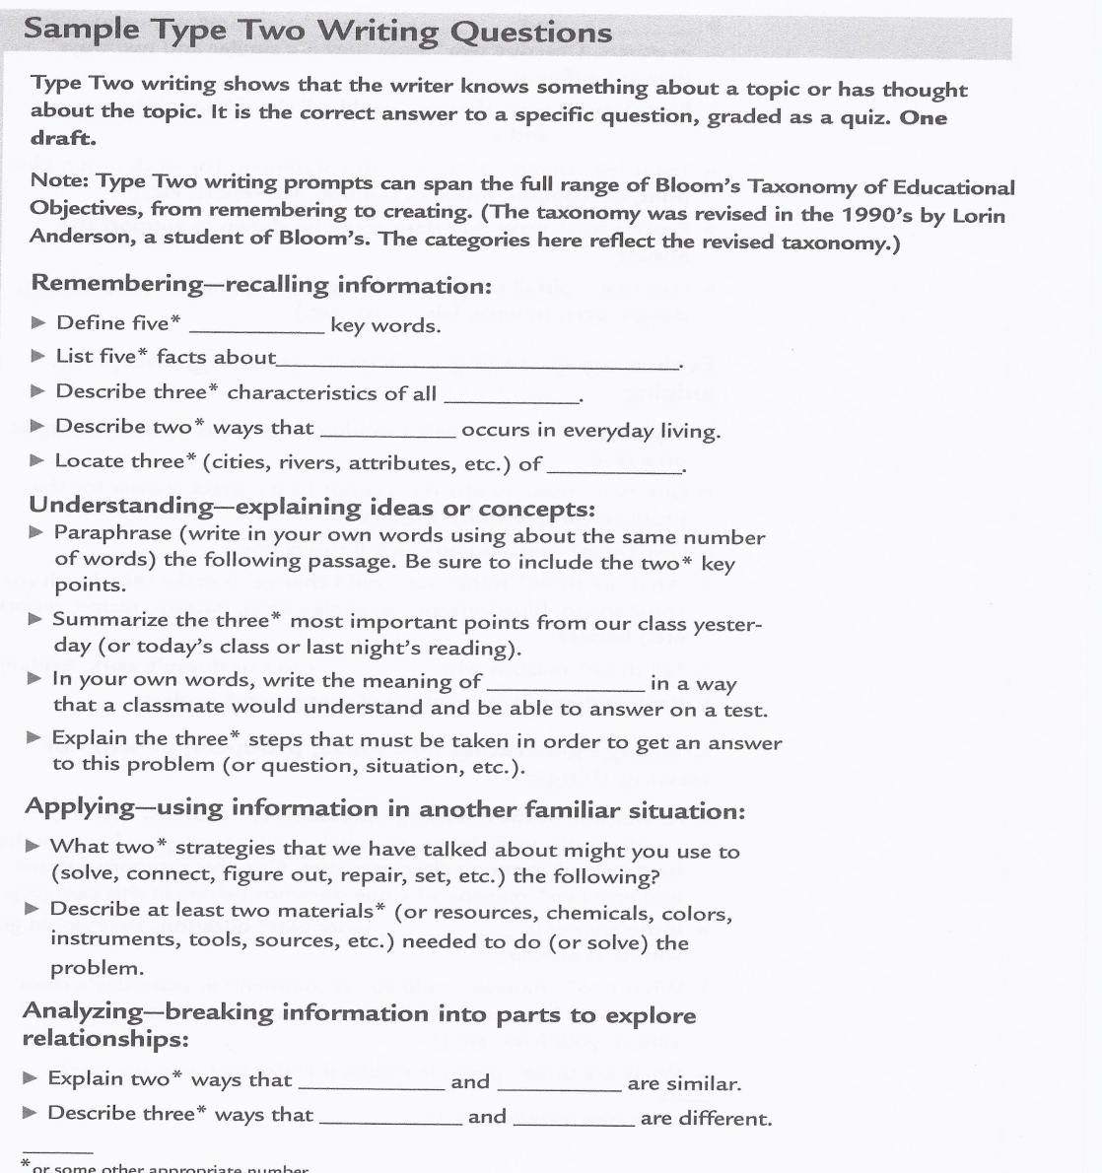
SAMPLE TYPE 2 WRITING PROMPTS

Slide 11
TYPE 3 WRITING
Writing that has substantive content and meets up to three specific standards called focus correction areas
Must create a draft, read it out loud, and review it to ensure it completes the assignment and addresses the focus correction areas(FCA’s)
Includes FCA’s and oral reading/editing

Slide 12
TYPE 3 WRITING
Reading their work out loud is the single most effective way to help students revise and edit
Oral reading can be done with all students in the class by reading in a “one-foot voice” which is a voice that cannot be heard by someone more than one foot away

Slide 13
TYPE 3 WRITING
Evaluated only in relation to the FCA’s
Students can earn points based on the points assigned to each criteria

Slide 14
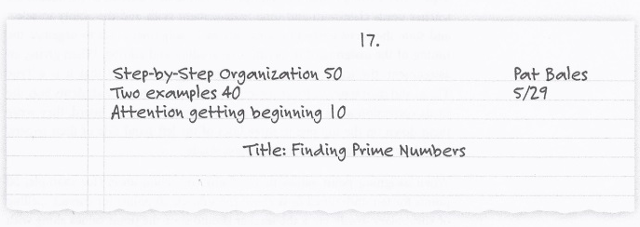
SAMPLE HEADING FOR TYPE 3 WRITING FCA’S

Slide 15
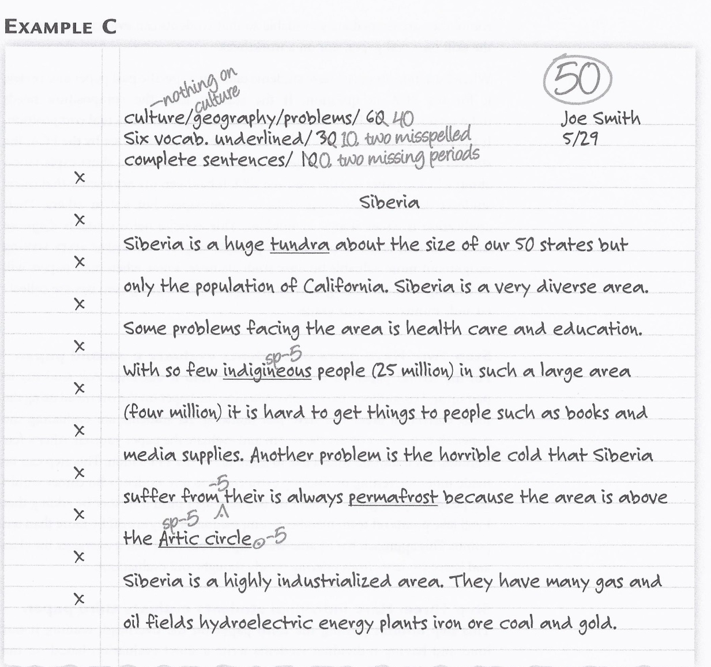
EXAMPLE OF TYPE 3 WRITING

Slide 16
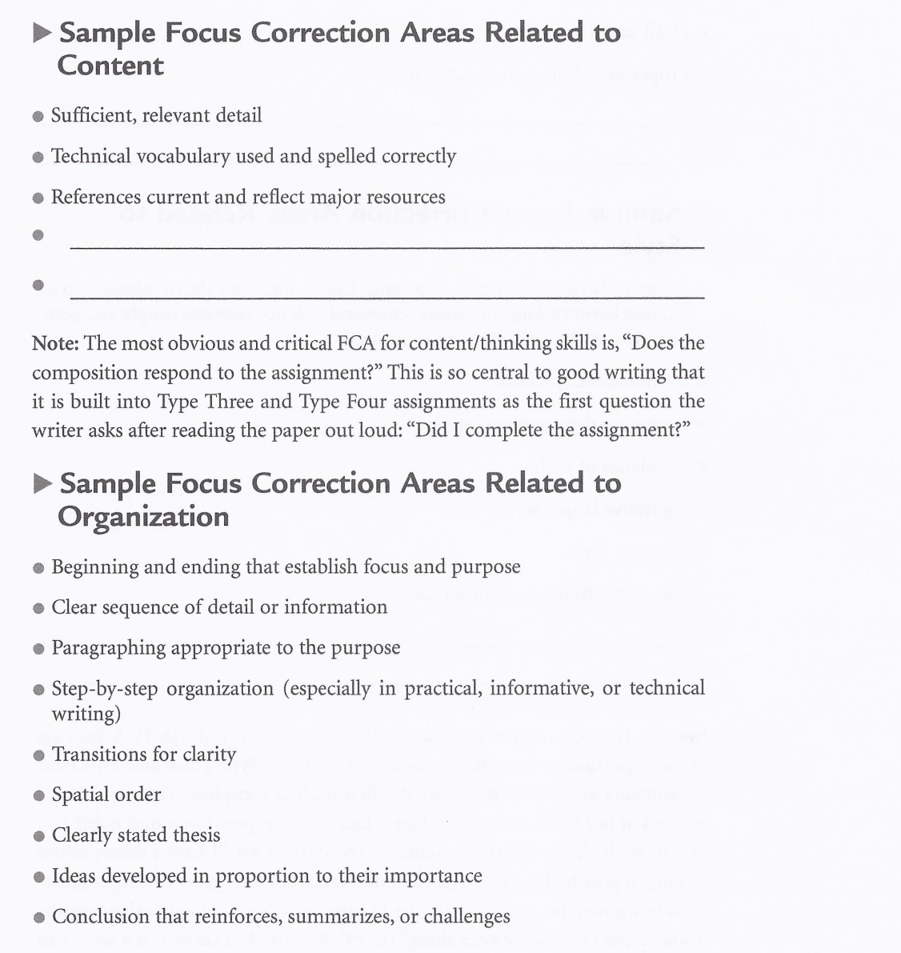
SAMPLE FCA’S

Slide 17
TYPE 4 WRITING
Type four writing is type three writing that has been read out loud and critiqued by another.
Requires two drafts
Should produce well-written work
Two students sit together once they have completed their first draft
Both students then read an edit their own papers

Slide 18
TYPE 4 WRITING
Student then swap papers and listen to each other’s paper
Creates a community of learners because students help each other to edit their work
Requires more than one draft
Person who edits the paper must sign their name at the bottom

Slide 19
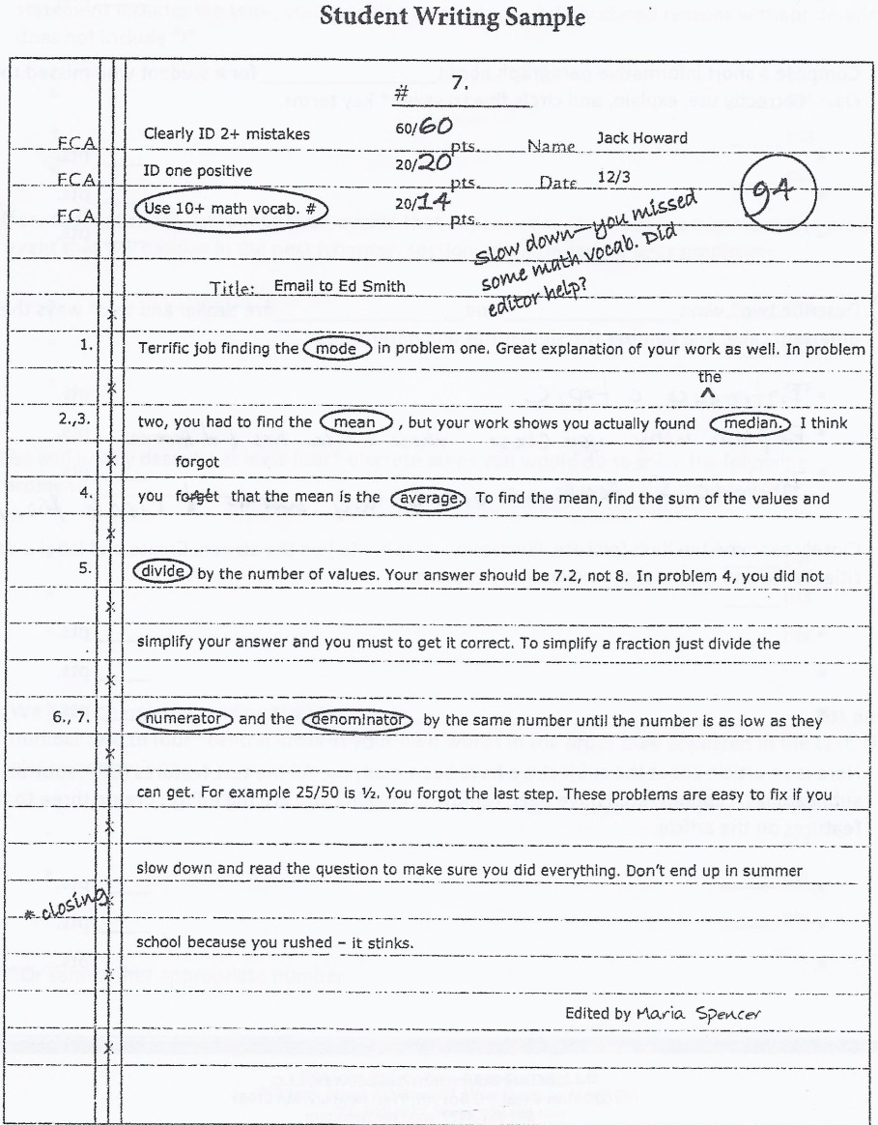
EXAMPLE OF TYPE 4 WRITING

Slide 20
TYPE FIVE WRITING
Type five writing is publishable quality
Achieving publishable quality requires multiple drafts, and should be considered a major project
Should include great content with no technical errors
Major assignment that will make up a significant portion of the student’s grade

Slide 21
COLLINS WRITING WEBSITE
COLLINS WRITING WEBSITE

